Slide 1
Static Analysis Tools
By
Winston TATWA IRUNGU

Slide 2
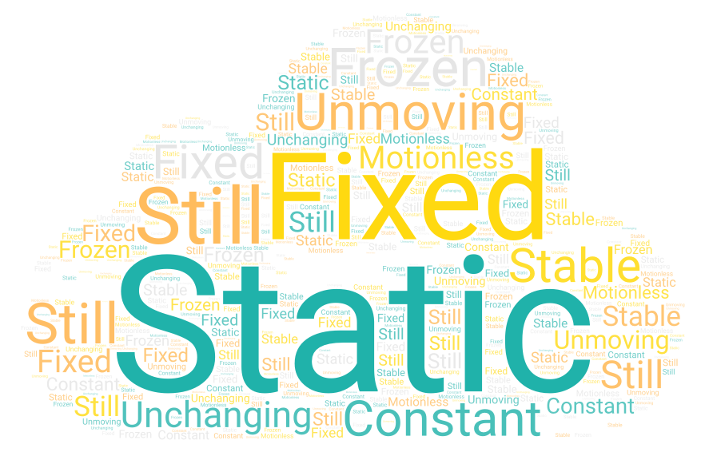
When you hear the word static, what’s the first thing that comes to mind?”

Slide 3
What is static analysis?
System verification without execution
Works on source code, design models, specifications
Detects errors early, before the software runs

Slide 4
Static vs Dynamic Analysis
Static Analysis
Checks code without running it
Focuses on code structure, models, and specifications
Detects errors early in development
Dynamic Analysis
Tests behavior by executing the program
Focuses on runtime conditions and outputs
Detects issues during or after execution

Slide 5
Static Analysis Techniques
Peer review & inspection – manual human checks
Design modeling checks – e.g., UML consistency
Formal verification – mathematical proofs
Model checking – automated theorem proving
Automated program analysis – tool-based code scanning

Slide 6
Static Analysis Tools (Automatic Static Analyzers)
Category | Tool
Frontend / JS | ESLint, Prettier
Python | Pylint, Bandit
Java | SpotBugs, Checkstyle
Enterprise | SonarQube, Coverity, Semgrep

Slide 7
Static Analysis: Benefits vs Drawbacks
Benefits
Early bug detection → cheaper fixes
Consistent coding standards across teams
Improves maintainability of long-lived projects
Supports security & reliability
Shift-left testing: issues caught early in lifecycle
Drawbacks
False positives (flags non-issues)
Requires setup & learning curve
Cannot detect runtime errors → dynamic testing still needed
May generate too many warnings (noise)
Can slow down builds in large projects

Slide 8
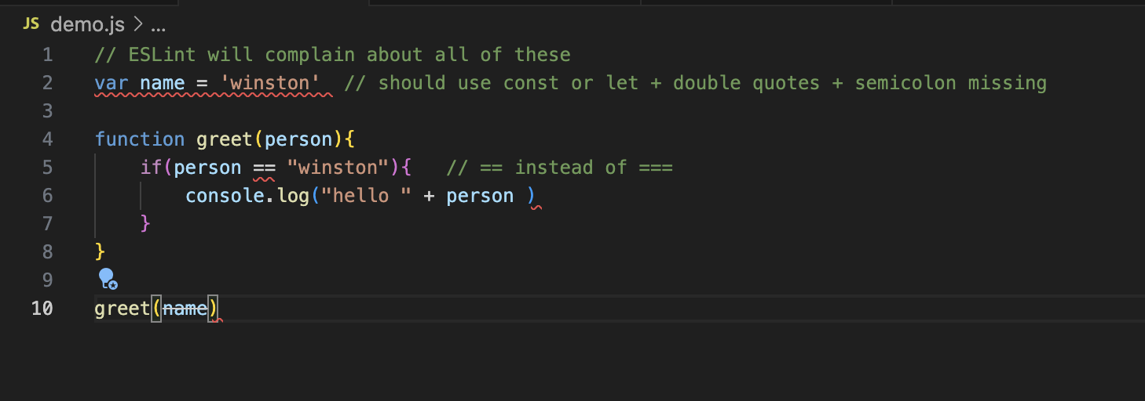
Demo using code snippets

Slide 9
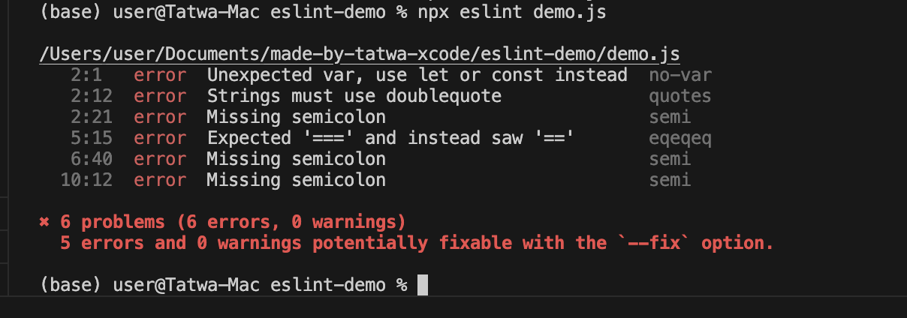
Demo using code snippets

Slide 10
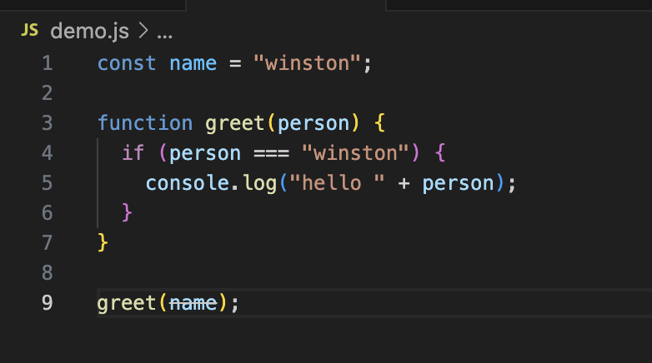
Demo using code snippets

Slide 11
References
Sommerville, I. (2015). Software engineering (10th ed.). Pearson.
Graham, D., van Veenendaal, E., Evans, I., & Black, R. (2014). Foundations of software testing: ISTQB certification (2nd ed.). Cengage Learning.

